Slide 1


Denys Marchenko
20.07.2022

Slide 2

Outline
Executive Summary
Introduction
Methodology
Results
Conclusion
Appendix

Slide 3
Executive Summary
Summary of methodologies:
Data was collected from SpaceX API and a wikipedia.com HTML table, labeled with success/failed labels, discovered with SQL queries, Folium visualization and a dashboard. Then the data was normalized, changed, fitted to SVM, KNN, LR and Decision Tree models using the method Grid Search. As a conclusion, accuracy was calculated and compared.
Summary of all results:
Was defined that the models requires more data then 18 samples for dataset. However, the accuracy on a test set is equal to 83.33% for landing the 1st stage booster. Therefore, the best way is keep searching information and analyzing

Slide 4
Introduction
Project background and context:
SpaceX advertises Falcon 9 rocket launches on its website with a cost of 62 million dollars; other providers cost upward of 165 million dollars each, much of the savings is because SpaceX can reuse the first stage. Therefore if we can determine if the first stage will land, we can determine the cost of a launch. This information can be used if an alternate company wants to bid against SpaceX for a rocket launch. Furthermore, trend for space travel is increasing.
Data collection methodology:
Will the Falcon 9 first stage land successfully?
What factors do determine successful rocket landing
Relationships between variables to discover ones with the biggest impact

Slide 5

Section 1

Slide 6
Methodology
Executive Summary
Data collection methodology:
Data was collected using a get request from a module “requests” to SpaceX API and from a wikipedia.com HTML table
Perform data wrangling
Bad and good outcomes were classified and labeled in the data
Perform exploratory data analysis (EDA) using visualization and SQL
Perform interactive visual analytics using Folium and Plotly Dash
Perform predictive analysis using classification models
Scikit-learn library encomposes huge variety of classification models. 4 models were represented in the research: SVM, KNN, Decision Tree, Logistic Regression. Then models were trained hyperparameters were selected using method Grid Search. To determine the most efficient model, accuracy was calculated for each model

Slide 7
Data Collection
Data collection methodology:
Get request to SpaceX API
Web scrapping from Wikipedia
Data was obtained using “requests” module on SpaceX API. The obtained json file with raw data was converted into a Data Frame. Then the data was cleaned and missing values were replaced with mean. As the result, was obtained a Data Frame that contains 90 rows and 17 columns.
Web scrapping allowed to retrieve historical launch records which are highly important. The data was collected using “requests” module, as mentioned before, and Beautiful Soup for retrieving data from the raw HTML code. Then was obtained the exact table as on wikipedia.com (121 rows, 10 columns) plus the 11th manual column named “Time”

Slide 8
Data Collection – SpaceX API
Importing required modules
Import requests, pandas, numpy, datetime
Get request from API
response = requests.get("https://api.spacexdata.com/v4/launches/past")
Convert JSON into a Data Frame
data = pd.json_normalize(response.json())
Data cleaning
Filtering “Falcon 9”
data_falcon9 = launch_df[launch_df['BoosterVersion']!='Falcon 1']
data_falcon9.loc[:,'FlightNumber'] = list(range(1, data_falcon9.shape[0]+1))

Slide 9
Data Collection - Scraping
Importing required modules
Import requests, pandas, unicodedata, re, BeautifulSoup, sys
Request the Wiki page
response = requests.get("https://en.wikipedia.org/w/index.php?title=List_of_Falcon_9_and_Falcon_Heavy_launches&oldid=1027686922").text
Extract all columns
html_tables = soup.find_all('table')
Parsing HTML tables in a dictionary
Convert dictionary into a DF
data_falcon9 = launch_df[launch_df['BoosterVersion']!='Falcon 1']
data_falcon9.loc[:, 'FlightNumber'] = list(range(1, data_falcon9.shape[0]+1))
soup = BeautifulSoup(response, 'html5lib')
ths = first_launch_table.find_all('th')
for row in ths:
header = extract_column_from_header(row)
if header is not None and len(header) > 0:
column_names.append(header)
first_launch_table = html_tables[2]
column_names = []

Slide 10
Data Wrangling
The main goals of this section were: to receive data insides those are shown below, create labeled outcome column, determine the success rate which is equal to 66.67% (df["Class"].mean())
Number of launches on each site
df['LaunchSite'].value_counts()
Number and occurrence of each orbit
df['Orbit'].value_counts()
Number and occurrence of mission outcome per orbit type
landing_outcomes = df['Outcome'].value_counts()

Slide 11
EDA with Data Visualization
Scatter plot
Used to visualize the relationships between variables through each value
Bar chart
Presents categorical data with proportional lengths of rectangular bars to the values
Line plot
The best fits for visualizing trend of data in a time period

Slide 12
EDA with SQL
In the research was used RDBMS SQLite in Python environment
EDA was applied with SQL to get insights from the data. Next tasks were completed:
The names of the unique launch sites in the space mission
5 records where launch sites begin with the string 'CCA'
The total payload mass carried by boosters launched by NASA (CRS)the names of the unique launch sites in the space mission
Average payload mass carried by booster version F9 v1.1
List of the date when the first successful landing outcome in ground pad was acheived
List of the names of the boosters which have success in drone ship and have payload mass greater than 4000 but less than 6000
List of the total number of successful and failure mission outcomes
List of the names of the booster_versions which have carried the maximum payload mass
List of the records which will display the month names, failure landing_outcomes in drone ship ,booster versions, launch_site for the months in year 2015
Ranked count of successful landing_outcomes between the date 04-06-2010 and 20-03-2017 in descending order

Slide 13
Build an Interactive Map with Folium
All launch sites were marked on a map (4 Launch Sites in Total = 4 marks)
Color markers were added to the Data Frame for identifing launches’ successful, therefore, markers of each launch was added on the map
The distances were calculated between a launch site and some objects to answer the questions:
Are launch sites in close proximity to railways?
Are launch sites in close proximity to highways?
Are launch sites in close proximity to coastline?
Do launch sites keep certain distance away from cities?

Slide 14
Build a Dashboard with Plotly Dash
Drop-down list
Allows to choose one value and filter the rest of visual elements
Bar chart
Illustrates numerical proportion of each element
Slider
Filters values of the dataset by moving an indicator
Scatter plot
Demonstrates correlation between 2 variables

Slide 15
Predictive Analysis (Classification)
Define X, Y
Split the data into training and test date
Initialize models (LR, KNN, SVM, Decision Tree)
Create Grid Search objects for each model
Calculate accuracy of each model
Visualize the results on Confusion Matrixes
Use test sets to estimate performance of the models

Slide 16
Results
Exploratory data analysis results
Interactive analytics demo in screenshots
Predictive analysis results

Slide 17

Section 2

Slide 18
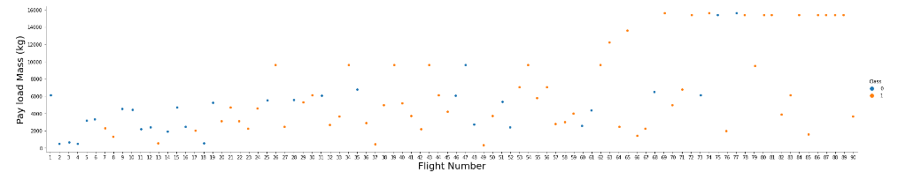
Flight Number vs. Launch Site
As the flight number increases, the first stage is more likely to land successfully. Likewise, the more massive the payload, the less likely the first stage will return

Slide 19
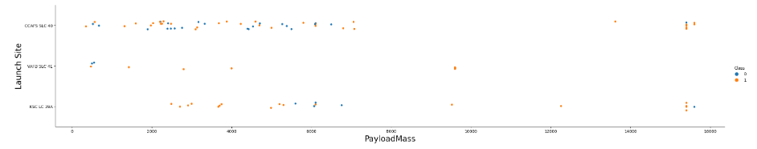
Payload vs. Launch Site
The chart demonstrates that very high value of Payload Mass occurs higher success of a launch

Slide 20
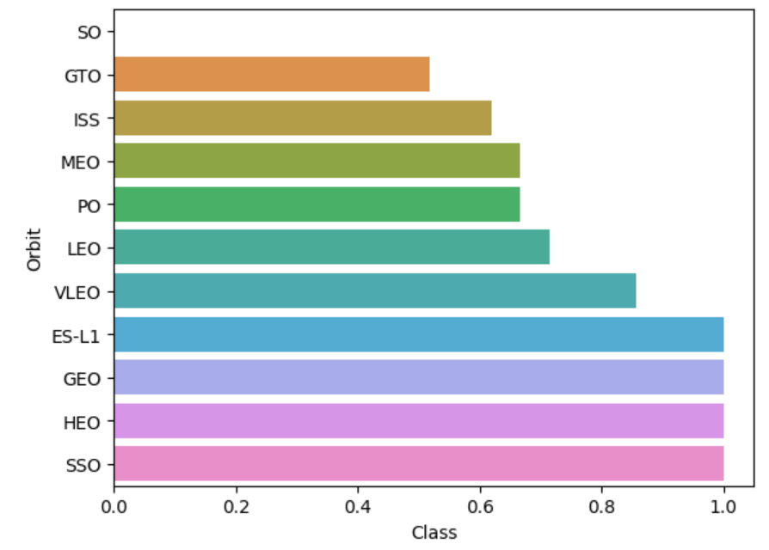
Success Rate vs. Orbit Type
As we can see on the bar chart, SSO, HEO, GEO and ES-L1 orbits have the highest success rate
On the other hand, GTO and ISS have the worst estimated success rate

Slide 21
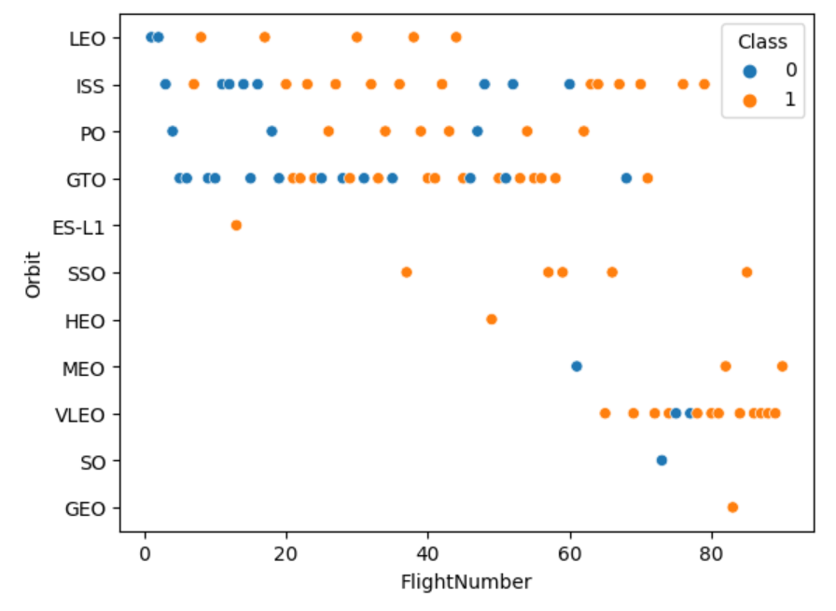
Flight Number vs. Orbit Type
In the LEO orbit the success appears related to the number of flights
Meanwhile, there seems to be no relationship between flight number when in GTO orbit

Slide 22
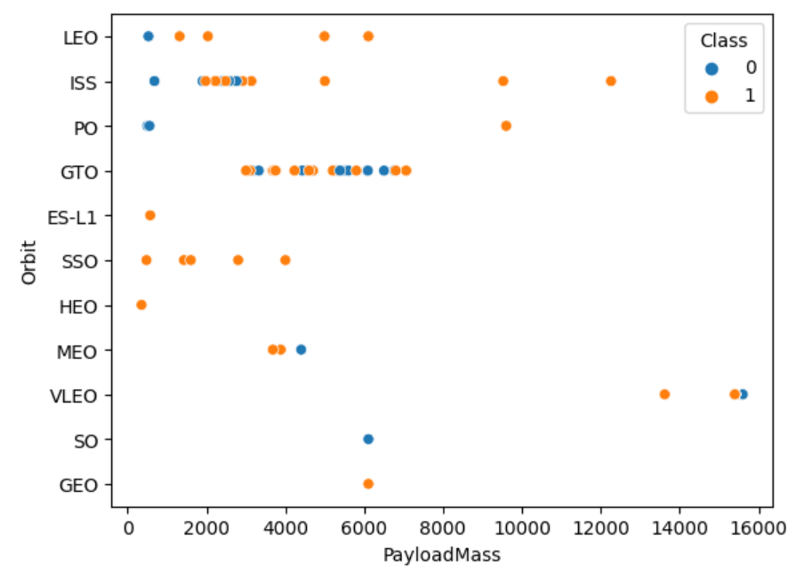
Payload vs. Orbit Type
With heavy payloads the successful landing or positive landing rate are more for LEO and ISS.
However for GTO we cannot distinguish this well as both positive landing rate and negative landing(unsuccessful mission) are both there here.

Slide 23
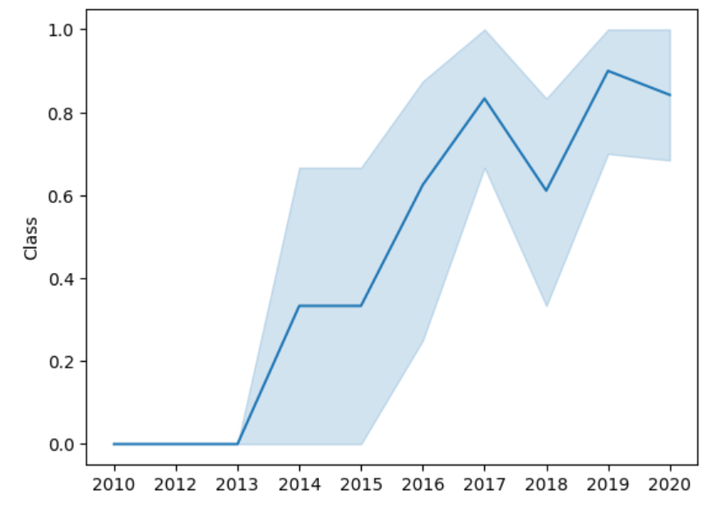
Launch Success Yearly Trend
The line chart demonstrates that the success rate have been increasing since 2013

Slide 24
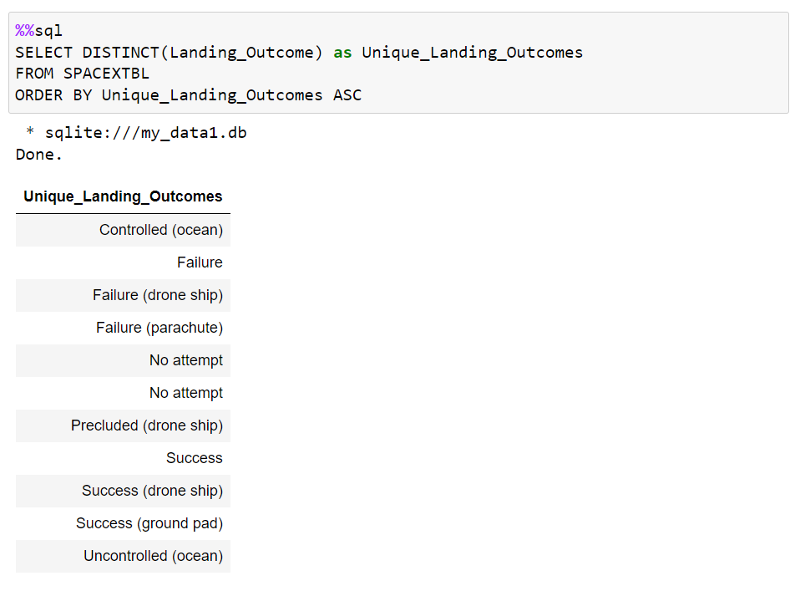
All Launch Site Names
To display unique parameters of a column, DISTINCT() function is used. To do so, set column name as an argument

Slide 25
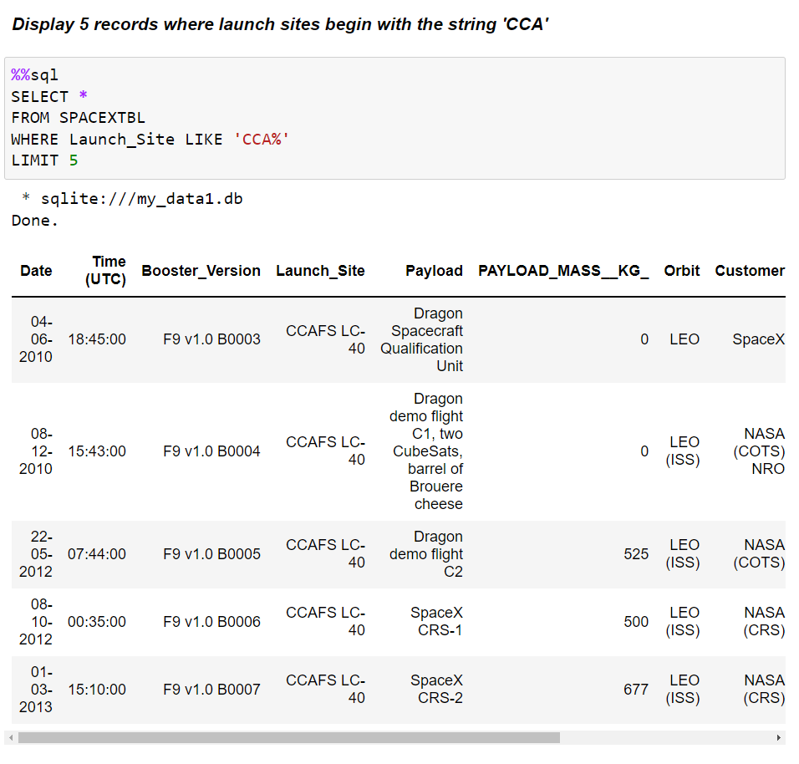
Launch Site Names Begin with 'CCA'
LIMIT was used to retrieve TOP 5 records in SQLite code
Data filtering is being done into the WHERE statement

Slide 26
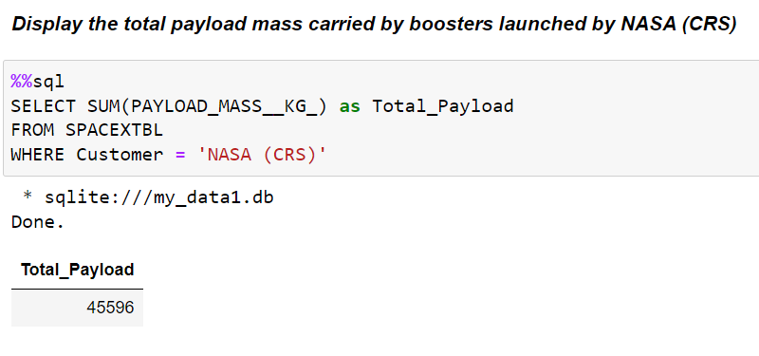
Total Payload Mass
SUM() is an aggregation function that takes a numerical column as a parameter and returns sum of the column

Slide 27
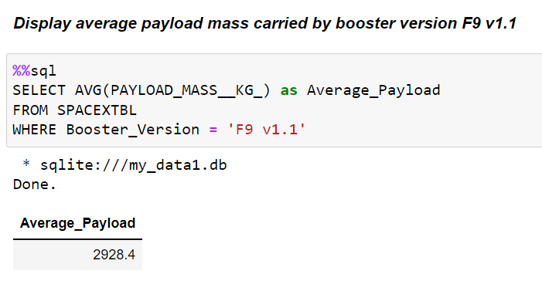
Average Payload Mass by F9 v1.1
The main idea behind AVG() is properly the same as for SUM(). It takes a numerical column as an argument and returns an average value

Slide 28
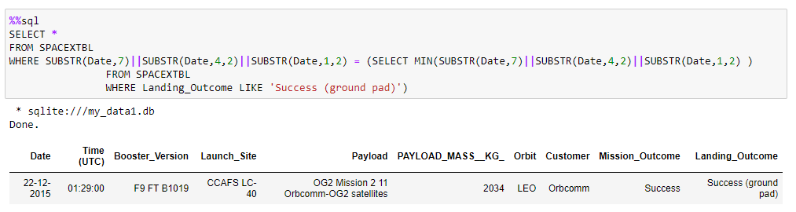
First Successful Ground Landing Date
To retrieve the date when the first successful landing outcome in ground pad was achieved, a query have to filter date through a subquery in the WHERE statement. As SQLite doesn’t provide date type, an interpretation with SUBSTR was used

Slide 29
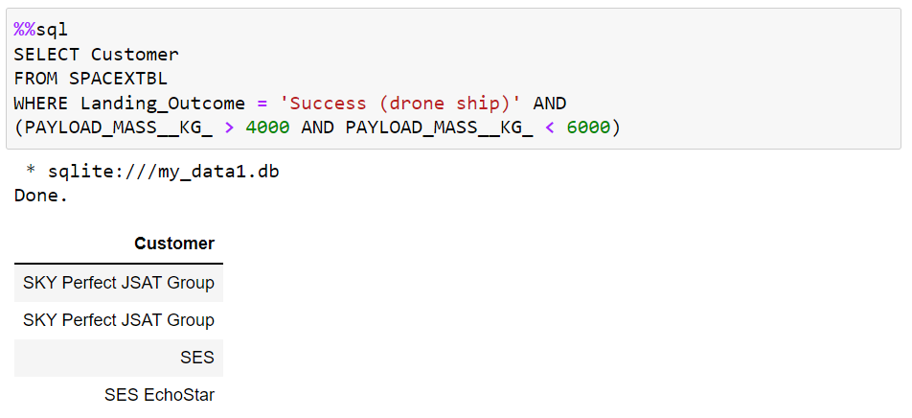
Successful Drone Ship Landing with Payload between 4000 and 6000
To filter data in this way, operator AND was used into the WHERE clause

Slide 30
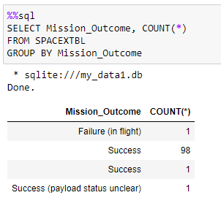
Total Number of Successful and Failure Mission Outcomes
Rows of the data base were countered and grouped to get a list of mission outcomes

Slide 31
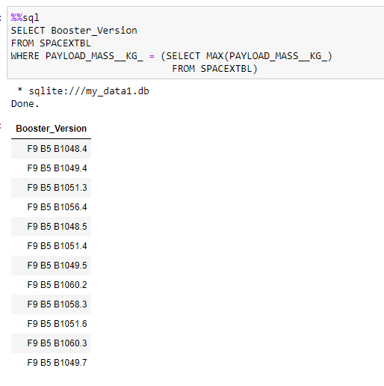
Boosters Carried Maximum Payload
In this case was used the similar approach as for date filtering. The subquery contains maximum value in WHERE clause

Slide 32
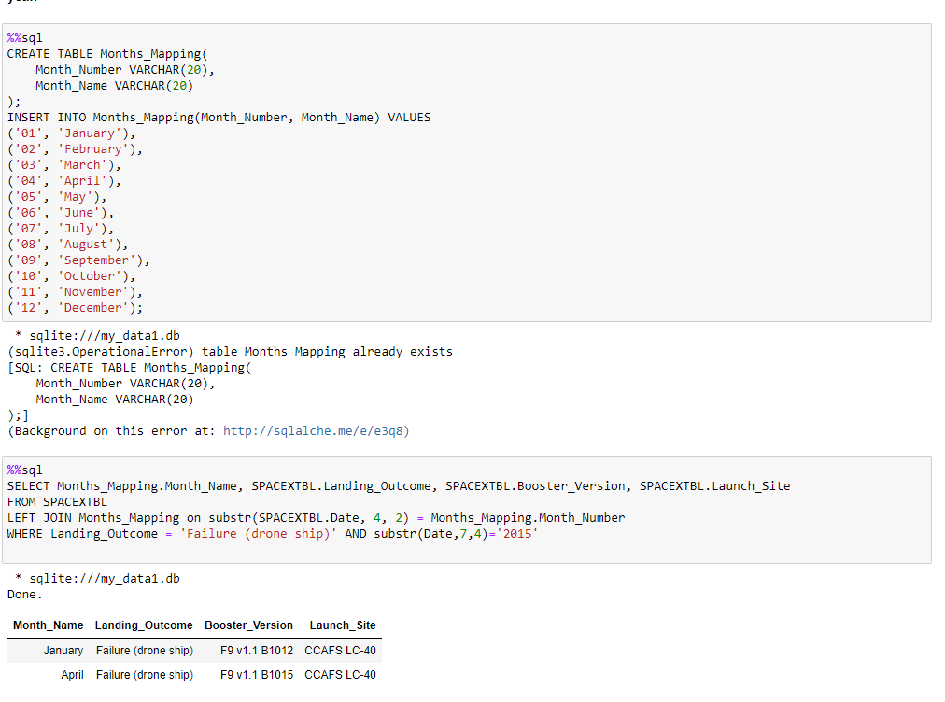
2015 Launch Records
For converting date into month names, a mapping table was created. Then the mapping table was joined to the core data base (LEFT JOIN) and filtered in the WHERE clause with operator AND

Slide 33
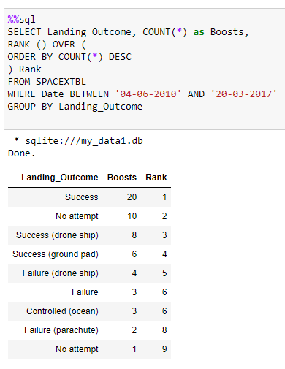
Rank Landing Outcomes Between 2010-06-04 and 2017-03-20
Ranking in SQLite provides through RANK () OVER (ORDER BY …) RANK
Further code is similar to previous cases with WHERE, AND, GROUP BY

Slide 34

Section 3

Slide 35
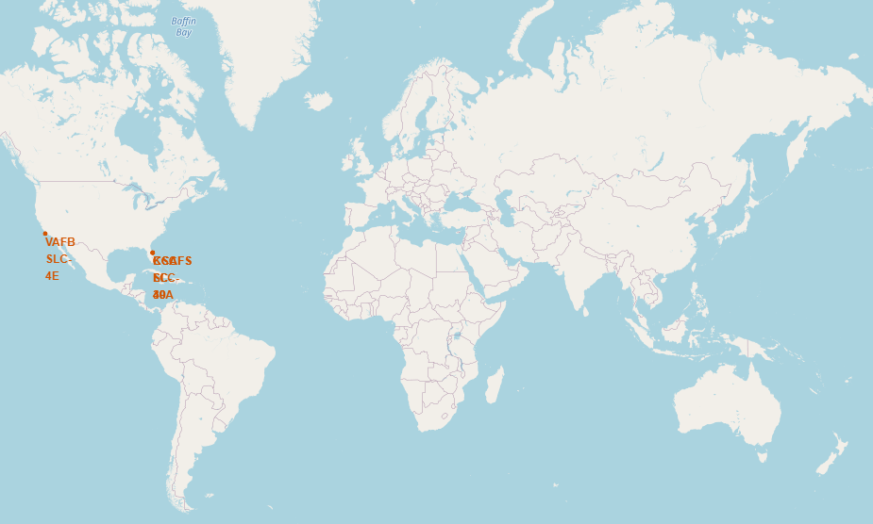
Launch Site on a global map
All launch sites based in the USA coasts (Florida and California)

Slide 36
Launch Sites successful outcomes
CCAFS LC-40
VAFB SLC-4E
KSC LC-39A
CCAFS SLC-40
 | Successful launch
 | Failed launch

Slide 37
Distance from CCAFS SLC-40 to infrastructure elements
Highways (close proximity)
City (faraway)
Railways (close proximity)
Coast (close proximity)

Slide 38

Section 4

Slide 39
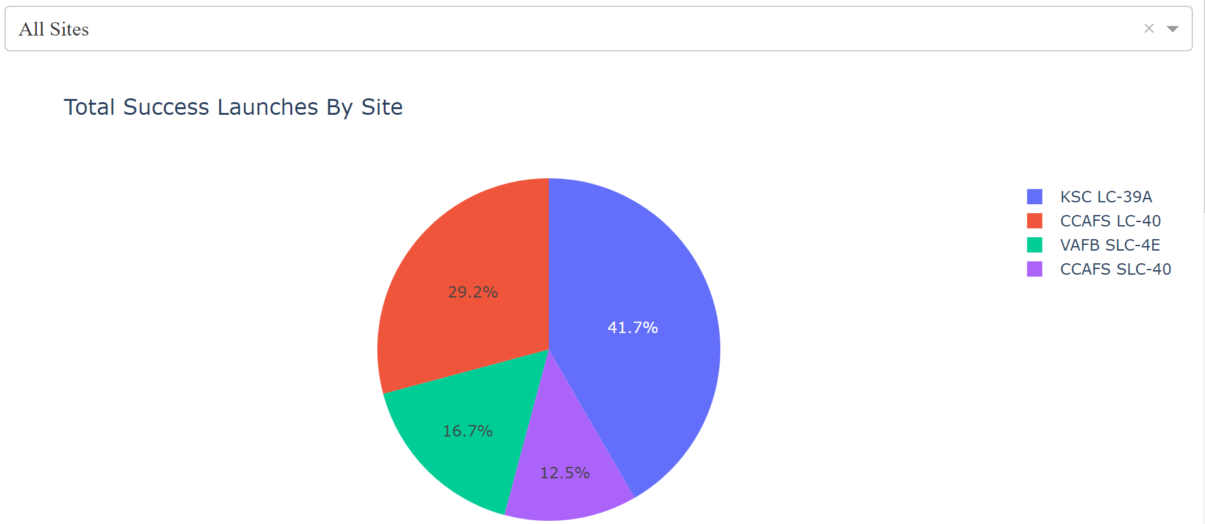
Success ratio in terms of launch sites
Respectively to the pie chart above, KSC LC-39A has the greatest percentage of successful Launces

Slide 40
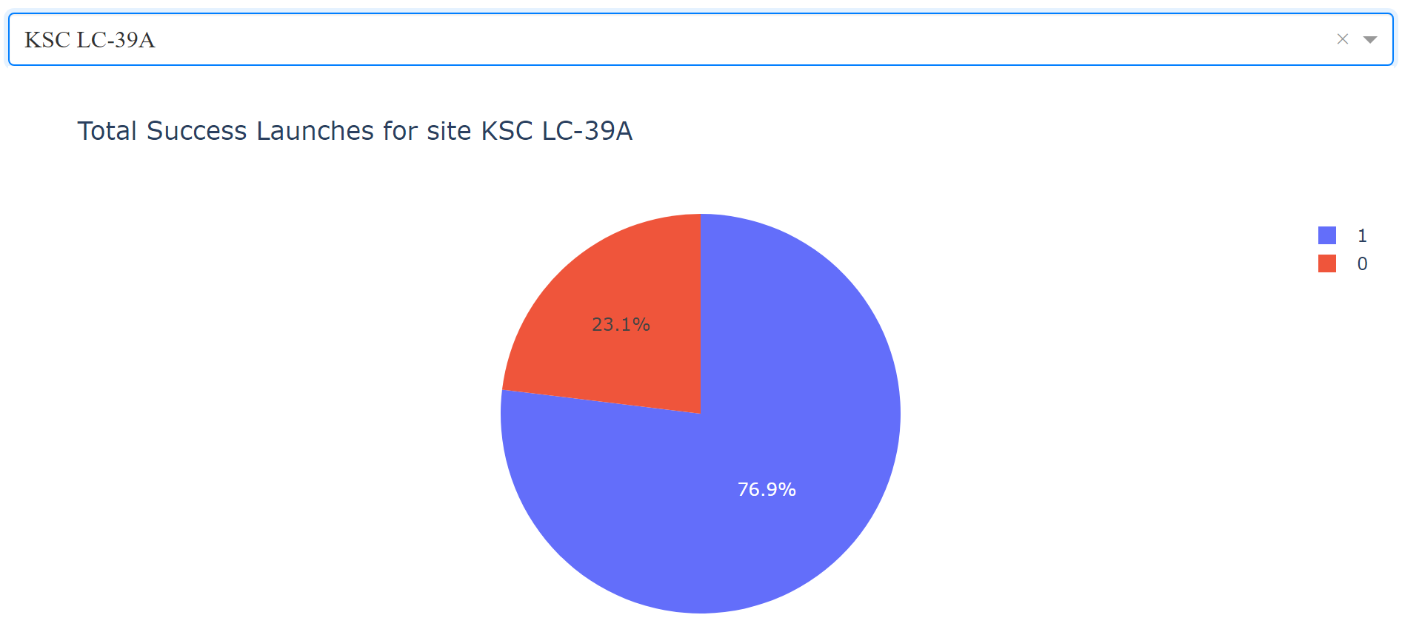
KSC LC-39A success/fail ratio
KSC LC-39A achieved a 76.9% success rate which is a splendid work

Slide 41
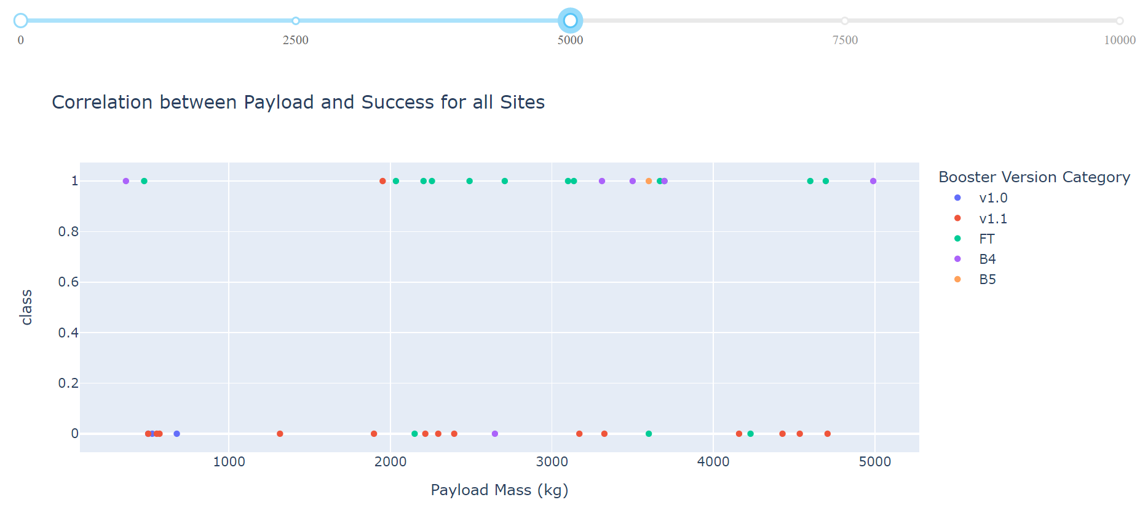
Correlation between Payload and Success in terms of Booster Version
The best performance is observed on the scatter plot with “FT” Booster. “v1.1” Booster has the lowest rate of success.

Slide 42

Section 5

Slide 43
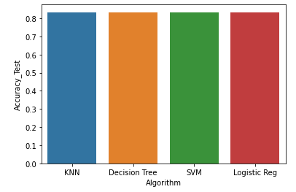
Classification Accuracy
Given test data was fitted for the entire stack of algorithms. As shown on the bar chart, all of the algorithms have exactly the same value of accuracy.
The phenomena was caused because of small sample of data.
Besides, small sample of data negatively affects on further iterations, for instance, large variance in accuracy (as example, Decision Tree)

Slide 44
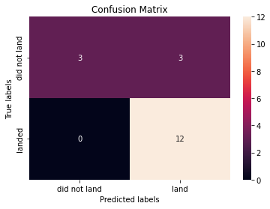
Confusion Matrix
Confusion Matrix is undistinguished due to the same accuracy across all models
Confusion Matrix insides:
12 True Positives
3 True Negatives
3 False Negative (which are erroneous)

Slide 45
Conclusions
Was defined that the models requires more data then 18 samples for dataset. However, the accuracy on a test set is equal to 83.33% for landing the 1st stage booster
Launch success rate have been increasing since 2013
KSC LC-39A is the most successful launce site and should be analyzed in more details
The most successful launces were observed with higher Payload Mass and “FT” Booster Version
Successful rate increases with number of flights

Slide 46


